Slide 1
Congress

Slide 2
A Bicameral Congress
The Framers of Congress created a bicameral legislature because…
They were familiar with the British system of government.
Fulfilling the Connecticut (Great) Compromise
Implementing federalism
2 types of federalism
House represents the people
Senate represents the interest of the states
It fragments power
Slows the legislative process (deliberation)

Slide 3
Differences in House & Senate
House
Senate

Slide 4
Differences in House & Senate
House
435 members
7 year citizen
25 years old
2 year terms
Senate
100 members
6 year terms
30 years old
9 year citizen

Slide 5
House |  | Senate
District | Constituency | Whole state – originally chosen by the state. Changed by the 17th Amendment
Strict | Formality of Rules | Flexible
Unequal | Representation | Equal
Limited | Debate | Filibuster/Cloture
Policy Specialist Powerful Committee Chairpersons | Expertise | Policy Generalist
Less Prestigious | Importance | More Media Coverage
Riders are allowed | Riders | Riders are not allowed
Impeachment Charges, initiates appropriation bills and chooses President when electoral college is deadlocked | Special Powers | Ratifies Treaties, judge impeachment cases, appointment confirmation

Slide 6
House of Representatives
People
Speaker – Official leader of the House
Majority Leader
Minority Leader
Party Whip
More people so have stricter rules and less debate

Slide 7
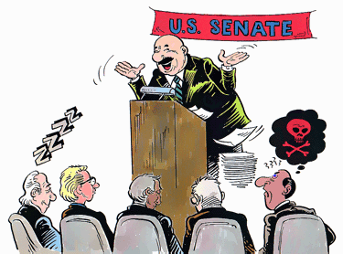
Senate
People
Vice President – official leader
President Pro Tempore – acting or day-to-day leader
Majority Leader
Minority Leader
Party Whip

