Slide 1
Congressional Apportionment

Slide 2
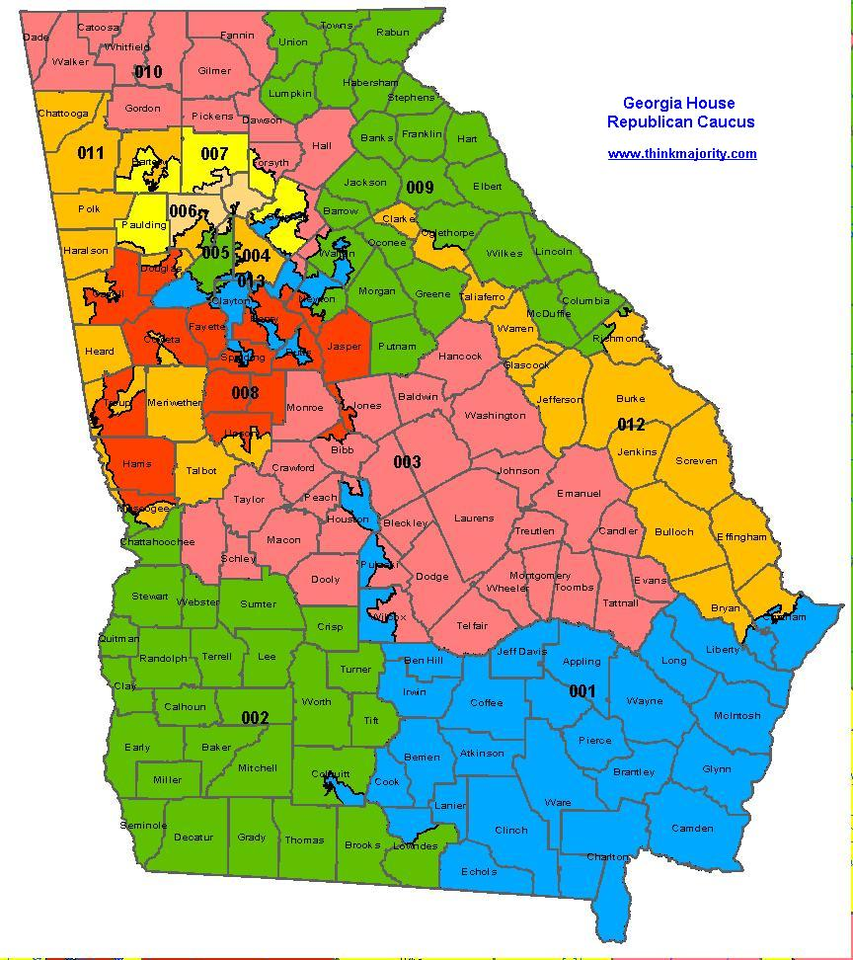
Census and Reapportionment
The Constitution directs Congress to reapportion House seats and districts in year after census.
The Reapportionment Act of 1929 set the permanent size of the House to 435.
As a result, each seat represents an average of 700,000 people.
Reapportionment is also important because it impacts the number of electors each state receives.

Slide 3
Population Shifts
Rustbelt to the sunbelt.
Since 1990
CA +7
PA/NY -2
NC +1

Slide 4
Census and Reapportionment
All districts must be equal by law
Equal in pop. not size
Reynolds v. Simms
One man = one vote
State legislature draws lines
VERY PARTISAN aka political.
No constitutional mandate of racial/ethnic representation.

Slide 5
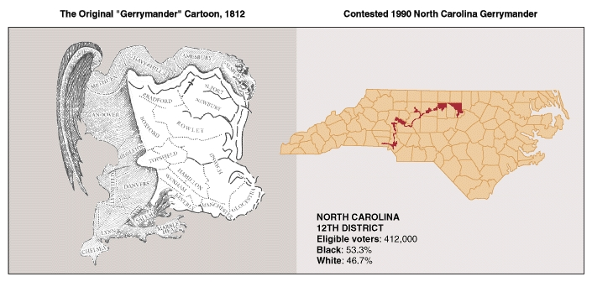

Slide 6
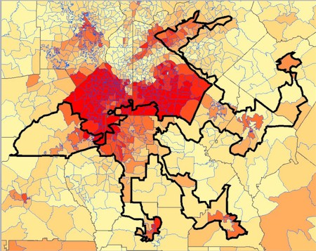
Gerrymandering
Consequences of Gerrymandering …
Protects incumbents
Strengthens the majority party while weakening the opposition
Increases or decreases minority representation

Slide 7
Gerrymandering
Supreme Court limits on redistricting.
Must be compact
Boundaries must be contiguous, or connected (cannot start and stop)
Cannot dilute minority voting
Cannot be drawn solely on race
Redistricting is subject to federal court suits, although it has not been eliminated.
Baker v Carr
GOP is in favor of majority/minority districts to cut down strength of minority vote.

Slide 8
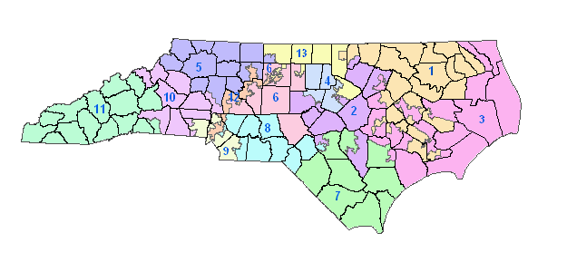
Cracking and Packing
Crack - divide members in a district up
Pack - pack a group into a district
Types:
Majority/minority - crack majority to make them a minority.
Minority/majority- pack minority in a district so they become a majority.

Slide 9
Incumbents in Congressional Elections

Slide 10
Reasons Why Incumbents Win
Money
Usually raise more than the challengers
PAC’s give more
Outspend 2 to 1
Visibility
Better known do to opportunities in the media
Constituent service
Bringing home money and jobs (“pork”)
Franking Privilege
Has been extended to include emails and recorded phone calls
Helps with name recognition
Gerrymandering
Incumbents usually represent gerrymandered districts discouraging challengers

Slide 11
Consequences of Incumbent Wins
Experience in Congress
Discourage radical change because of continuity
No incentive to reform campaign finance laws

