Slide 1
How Congress is Organized

Slide 2
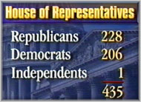
Role of Political Parties
Majority Party – Party with the most votes and enjoys several advantages because of more votes
Holds committee chairs
Choose Speaker
Assign bills to committee
Holds majority in each committee
Controls House Rules Committee
Sets the legislative agenda
Minority Party – Party with second most votes

Slide 3
The Committee System
Committees play an important role in both houses and an particularly dominate role in policymaking
Standing Committees
Permanent bodies that focus on legislation
All bills are sent to committee to be passed, amended, or killed
Foster development of expertise
Divided into subcommittees for legislative details to be worked out
Select Committees
Temporary and usually to investigate a matter of public concern (JFK, steroids)
Joint Committees
Include members of House and Senate and usually focus on matter of public attention.
Conference Committees
Temporary committee to iron out the differences in House and Senate version of a bill

Slide 4
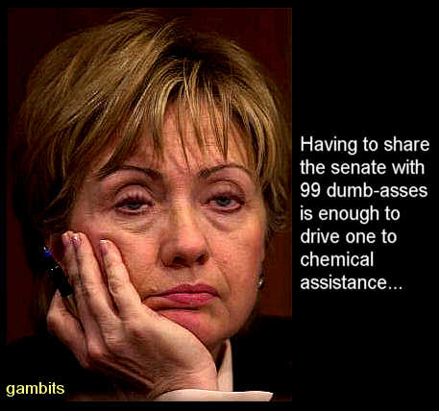
Committees continued
House Rules Committee
Controlled by Speaker
Called “traffic cop” or Speakers “right arm”
Sets guidelines for floor debate
Gives each bill a rule on the legislative calendar
Closed Rule - strict time limits and no amendments
Open Rule – less strict time limit and permits amendments
House Committee on Ways and Means
Jurisdiction over all tax, tariff and revenue raising measures.

Slide 5
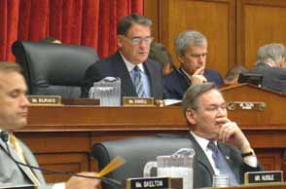
Committees continued
Committee Chairs
Call meetings, schedule hearings, hire staff, recommend members for conference committees and select sub-committee chairs
Historically, committee chairs were chosen by the seniority system (those with the most continuous years service would be chair)
More recently, these are elected positions; however, seniority is still the norm.

