Slide 1
The 14th Amendment and the Incorporation Theory

Slide 2
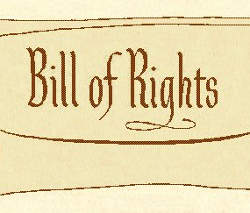
The 1st 10 Amendments were intended to protect citizens, but from whom were we to be protected?

Slide 3
Venn Diagram
Barron v Baltimore | Similarities | Gitlow v New York

Slide 4
Barron v Baltimore (1833)
John Barron owned a wharf in Baltimore. He claimed the city of Baltimore damaged his business and argued that they owed him compensation based on the fifth amendment.
Do they? Does the City of Baltimore owe Barron compensation?
John Marshall ruled – the Bill of Rights “contains no expression of… applying them (rights) to the states”. Therefore, a precedent that the freedoms guaranteed the BOR did not restrict the state governments.

Slide 5
14th Amendment
“No state shall make or enforce any law which shall abridge the privileges or immunities of citizens of the United States nor shall any state deprive any person of life, liberty, or property, without due process of law; nor deny to any person within its jurisdiction the equal protection of the laws.”
Due Process Clause
Equal Protection Clause

Slide 6
Gitlow v New York (1925)
Benjamin Gitlow was arrested for a pamphlet he wrote urging people to revolt and overthrow the organized government. He argued that the state had violated his right to freedom of speech and his freedom of press.
Based on what you know (Barron v Baltimore) what would be the ruling of this case?
Is he guaranteed protection from the state in his rights to freedoms of speech and press?
The Supreme Court ruled that “freedom of speech and press… are among the… rights and liberties protected… from impairment by the states,” thus begins the incorporation process.

Slide 7
The Doctrine of Incorporation
Incorporation (of the Bill of Rights) is the American legal doctrine by which portions of the Bill of Rights are applied to the states through the Due Process Clause of the Fourteenth Amendment.
When the Supreme Court only incorporates a particular portion of an amendment it is called selective incorporation.
This did not happen at once, but through a series of court cases
The Doctrine of Incorporation is important because it allows the national government to overturn state and local practices.
Example: Before Gideon v Wainwright, Florida did not provide lawyers for accused people. This court case gave people in all states that right.

