Slide 1
Constitutional Underpinnings
Origins, Articles & Framers

Slide 2
Colonial Bingo
Declaration Of Independence | Article of Confederation | Virginia Plan | New Jersey Plan | Great Compromise
House Of Burgesses | John Locke | Common Sense | Baron de Montesqui | Magna Carta
English Bill of Rights | The Enlightenment | FREE SPACE | Thomas Hobbs | Thomas Jefferson
Mayflower Compact | Fundamental Orders of Connecticut | Shay’s Rebellion | Anti-Federalist | Constitution of the United States
Jean Jacques Rosseau | The Preamble | Federalist | Northwest Ordinance of 1787 | Bill of Rights

Slide 3
Colonial Bingo
Declaration Of Independence -document announcing our freedom and outlining a republican form of government | Article of Confederation -First national government created after Revolution where the states had the majority of the power | Virginia Plan -idea that in the new Congress representation should be based on population | New Jersey Plan -idea that in the new Congress representation should be equal | Great Compromise -a Compromise between the NJ and VA plans where we created a two house government
House Of Burgesses -First legislative body in the New World. -Created a pathway to representative government. | John Locke -Wrote Two Treaties on Government -Believed in Natural Rights like life, liberty, and property -Suggested a branched government | Common Sense -pamphlet by Thomas Paine in 1776 emphasizing complete independence from England | Baron de Montesquieu -philosopher who emphasized the idea of separation of powers within a government | Magna Carta -limited King’s power and granted people rights
English Bill of Rights -1689 signed by new monarchs William and Mary. -Monarchs could not levy tax and gave people the right to a fair trial | The Enlightenment - Period called the Age of Reason, where people began to study and question the normal things of life. | FREE SPACE | Thomas Hobbs -wrote Leviathan suggesting govn’t is necessary to provide security and peace | Thomas Jefferson -wrote Declaration of Independence in which he outlined the philosophy of democracy or a republican form of government
Mayflower Compact -a document based on the principle of a social contract establishing a direct democracy in the New England Colonies | Fundamental Orders of Connecticut -first written constitution in the American colonies | Shay’s Rebellion -a farmer led rebellion that showed everyone how weak government was under the AOC | Anti-Federalist -group that believed in personal freedoms and believed that the state should retain its power instead of the federal government | Constitution Of the United States -our national government ratified in 1787 and continues to be our government today
Jean-Jacques Rosseau -wrote The Social Contract supporting democracy, freedom of religion and separation of Church and State | Preamble -beginning of the Constitution which set out the purpose of our new government | Federalist -group that believed in the nation would not survive without a strong national government | Northwest Ordinance of 1787 -Law made under the AOC that established how our country would set up new states and in those lands placed an importance on education | Bill of Rights -1st 10 amendments to the Constitution of the US guaranteeing citizens certain rights that cannot be taken away

Slide 4
Group alike things together and give each group a heading
Documents
Common Sense
Declaration of Independence
Magna Carta
Mayflower Compact
English Bill of Rights
Bill of Rights
Fundamental Orders of Connecticut
Articles of Confederation
People
Locke
Rousseau
Montesquieu
Jefferson
Madison
Paine
Hobbs
Groups
Anti-Federalist
Federalist
Governments
Fundamental Orders of Connecticut
Articles of Confederation
The Enlightenment
Locke
Rousseau
Montesquieu
Hobbs

Slide 5
Group alike things together and give each group a heading
Things – English
Magna Carta
English Bill of Rights
Glorious Revolution
Parliament
Books
Two Treaties on Government
Leviathan
The Social Contract
Common Sense
Compromises
Great Compromise
VA Plan
NJ Plan
Pairs
Article of Confederation & Shay’s Rebellion
Constitution & Bill of Rights
Common Sense & Declaration of Independence
House of Burgesses & Mayflower Compact

Slide 6
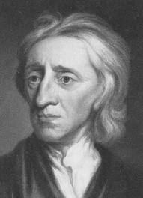
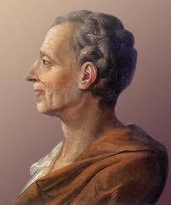
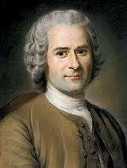
Intellectual Origin of the Constitution
The Founders used Enlightenment thinkers to justify opposition to the British government
Reason, natural laws, progress, liberty, toleration
Locke
Natural rights
Social contract
Baron de Montesquieu
3 branches
Jean-Jacques Rousseau
Popular sovereignty
Impeachment, recall

Slide 7
The Articles of Confederation
Strengths | Weaknesses
Created a “firm league of friendship” where the states retained “its sovereignty, freedom and independence | Weak central government (Remember a confederation is a government where the states have more power)
Won the War | Revenue Issues Due to not being allowed to tax
Northwest Land Ordinance | Could not regulate commerce
Created a unicameral Congress | Lacked 2 Branches of Government
 | Amendments require 13/13

Slide 8
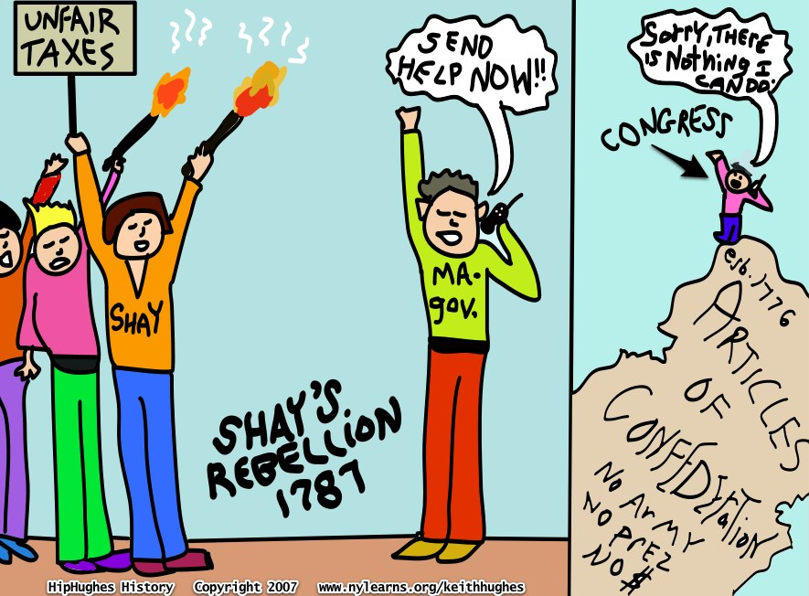
Shay’s Rebellion

Slide 9
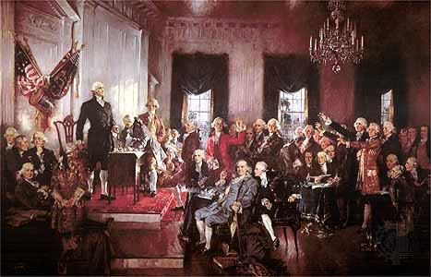
The Framers
Men at the Constitutional Convention
GW, Franklin, Hamilton, Madison, Adams, etc
Jefferson calls it an “assembly of demi-gods”
.
Shared Ideas by Framers
Human Nature
Self-centered
“love of power and love of money” Franklin
Political Conflict
Uneven distribution of wealth causes factions and conflict
Gov’t must regulate conflict
Solve problem between “excessive democracy” under AOC and tyranny under King
Solution= limited gov’t w/ checks and balances

