Slide 1
Constitutional Underpinnings
The Constitutional Convention and
An Overview of the 3 Branches

Slide 2
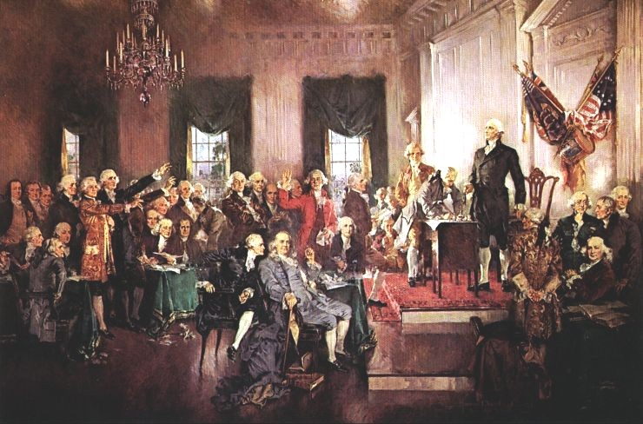
The Framers
55 delegates from 12 states (RI = no show)
7 Governors, 33 lawyers, 34 were college grads, 8 had signed the Dec. of Ind.
Washington presided
Madison the “father of the Constitution.”
Remember: the meeting was “for the sole and express purpose…” of revising the Articles of Confederation

Slide 3
Compromise and Consensus
Virginia Plan |  | New Jersey Plan
Large States | Who | Small States
Bicameral | Houses | Unicameral
Based on population | Representation | Equal regardless
The Connecticut or “Great Compromise” resolved this dispute by creating two houses. The Senate is based on NJ’s plan because each state has 2 Senators, while Virginia got their way in the House of Representatives because representation is based on population.

Slide 4
Compromise and Consensus
Southern Position |  | Northern Position
Yes Slaves accounted for 30% of the total population of theses states | Count slaves for Representation | No Slaves should not count unless we get to count our cattle
No | Count slaves for Taxes | Yes
The Three-fifths Compromise called for each slave to count as 3/5th of a person for both representation and tax purposes. Temporarily defused tensions between North & South.

Slide 5
Compromise and Consensus
The Framers assigned a high priority to solving economic issues, and did this by allowing the central government greater economic powers.
Looking in Article I, Section 8 (Red Book page 568)
Congress was given the power to: Found in Article I, Section 8
Obtain revenue through taxing
Pay debts
Coin Money
Regulate interstate and foreign commerce
Establish uniform laws of bankruptcy
Punish counterfeiting
Establish post offices

Slide 6
Compromise and Consensus
The Framers also agreed on the importance of safeguarding individual rights.
In what way does the Constitution protect our freedoms.
Protections of individual rights
Prohibits the suspension of habeaus corpus
Prohibits Congress from passing bills of attainder
Prohibits Congress, or state, from passing ex post facto laws
Upholds the right to trial by jury in criminal cases
Prohibits the use of religious qualifications for holding office

Slide 7
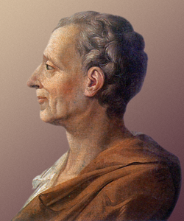
Separation of Powers
Madison’s 3 branches
Legislative = Congress
Executive = President
Judicial = Courts
Got this idea from Frenchman Baron de Montesquieu.
The Baron claimed that centralizing power was dangerous to the public welfare.

Slide 8
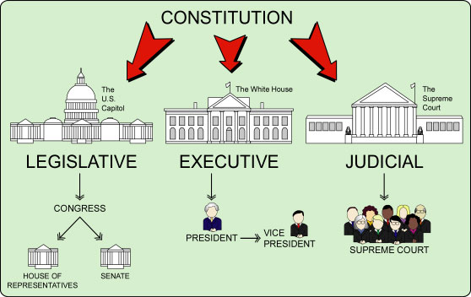

Slide 9
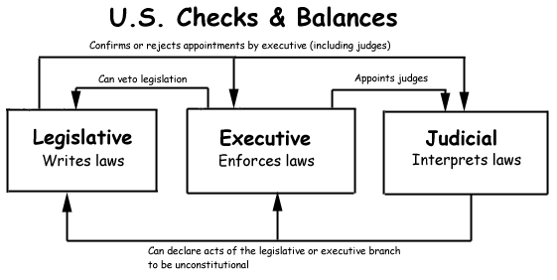

Slide 10
Constitution vs Articles - FRQ
2000 FRQ #1
Grading Scale
The Constitution was an attempt to address problems of decentralization that were experienced under the A.O.C.
List 3 problems of decentralized power that existed under the AOC. For each problem you listed, identify one solution that the Constitution provided to address the problem.
Some have argued that the tensions between decentralized and centralized power continue to exist. Support this argument by explaining how one of the following illustrates the continuing tensions.
Environmental policy
Gun control
Disability access

Slide 11
Constitution vs Articles - Answer
2000 FRQ #1
Grading Scale
3 points total
1 point for each problem clearly linked to a solution.
No credit for only problem or solution.
No credit if problem is not clearly listed.
Possible Examples of A:
Amendment Process | Power to tax/raise revenue
Creation of a dominant national legislature | Settle disputes between states
Creation of an executive | Supermajority
Interstate commerce | “Supremacy Clause”
National court system | Treaties
Power to coin money | Reference to other enumerated powers of Article I, section 8
Power to raise a military force

Slide 12
Constitution vs Articles - Answer
2000 FRQ #1
Grading Scale
2 points total
1 point for general description of specific continuing tensions between centralization and decentralization (federal/state; federal/local) with at least implicit linkage to one of the three policy areas.
2 points for a specific explanation of continuing tensions between centralization and decentralization (federal/state; federal/local) with explicit linkage to one of the three policy areas.

