Slide 1
Incorporation of the First Amendment

Slide 2
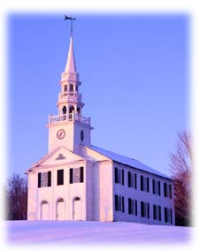
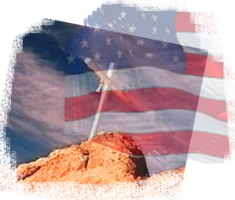
Freedom of Religion
The Establishment Clause
The Free Exercise Clause
Which one of these religious freedoms is the most important to you?

Slide 3
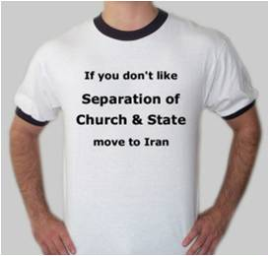
The Establishment Clause
Jefferson wrote that this clause created “a wall of separation between Church and State”
Forbids the government from supporting any particular religion.

Slide 4
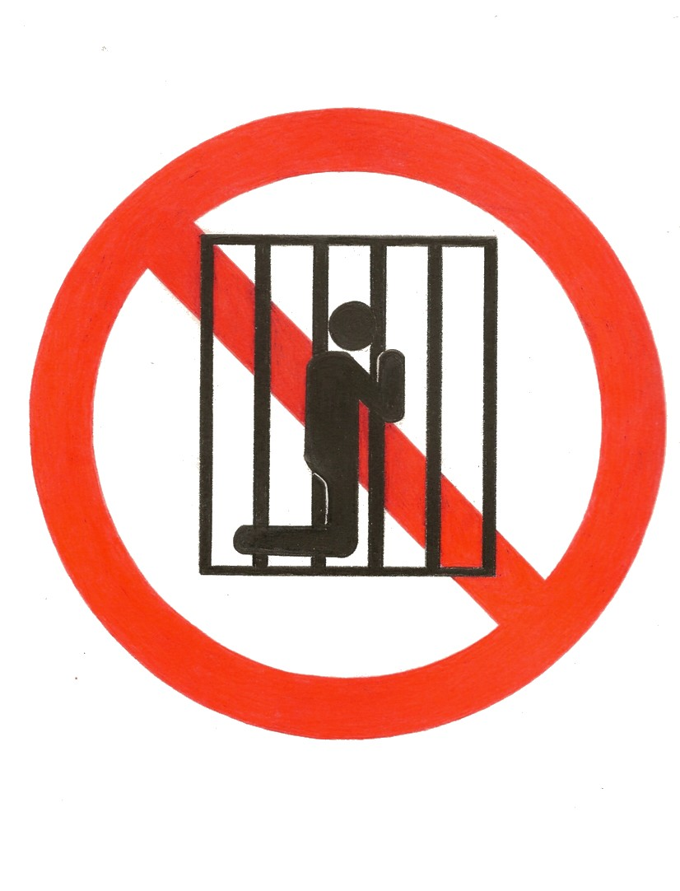
Free Exercise Clause
Prohibits the government from interfering with the practice of religion.

Slide 5
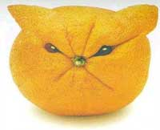
The Establishment Clause
School prayer
Engle v Vitale (1962)
State sponsored prayer violated the Establishment Clause and “breaks the constitutional wall of separation between Church and State.”
Wallace v Jaffree (1985)
Ruled that moment of silence was unconstitutional if intended for prayer.
Aid to parochial schools
Lemon v Kurtzman (1971)
Aid to church-related schools must meet the “Lemon Test” by passing these 3 test
Must have secular purpose
Government can neither advance nor inhibit religion
Government action must not foster “excessive entanglement” between government and religion.

Slide 6
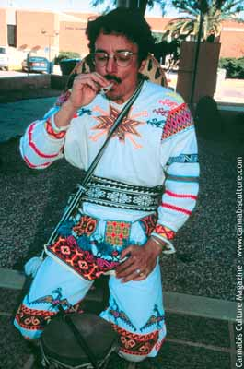
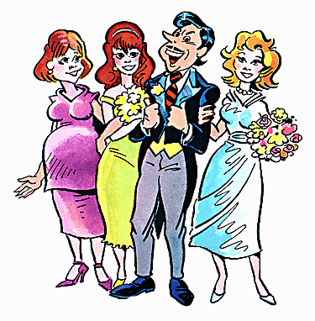
The Free Exercise Clause
This clause guarantees each person the right to believe what they want; however, a religion cannot make an act legal that would otherwise be illegal.
Oregon v Smith (1990)
Outlawed illegal drugs to be used for
religious practices
Limits on Free Exercise:
Reynolds v US (1879)
Supreme court ruled polygamy was unconstitutional because “beliefs would be superior to the law of the land.”
Wisconsin v Yoder ()
Amish people can remove children from school for religious purposes.

Slide 7
First Amendment (Religion) - FRQ
The First Amendment contains two clauses relating to the freedom of religion.
For each of the following cases, identify the First Amendment clause upon which the US Supreme Court based its decision and describe the court’s decision in that case.
Engle v Vital
Reynolds v US
Oregon v Smith
Lemon v Kurtzman
Many of the Supreme Court decisions have caused controversy in the United States. Describe two ways in which other political institutions might limit the impact of those decisions.

Slide 8
First Amendment Freedom of Speech

Slide 9
Get out your Court Case Notecards
National Supremacy Cases | Incorporation Doctrine Cases | Freedom of Speech and Press | Freedom of Religion | Rights of the Accused | Rights to Privacy
Marbury v Madison | Barron v Baltimore
McCulloch v Maryland | Gitlow v New York
Gibbons v Ogden

Slide 10
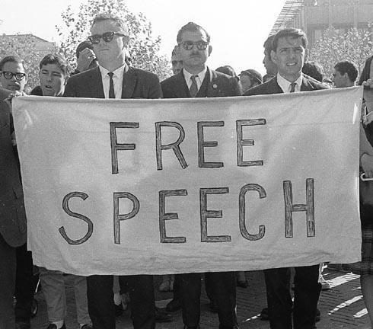
Freedom of Speech
The Framers believed that the right to free speech is a fundamental natural right.
The guarantees of free speech are intended to protect unpopular views and the right of the minority.

Slide 11
The “Clear & Present Danger” Test
The Espionage Act of 1917 prevented forms of dissent that are harmful to the nation’s war effort. Charles Schenck mailed 15,000 anti-war leaflets urging readers to resist the military draft.
Schenck v US (1919)
Every act depends on the circumstances
“Cannot yell fire in a theatre...”
Created a precedent that 1st Amendment guarantees of free speech are not absolute.
Brandenburg v Ohio (1969)
advocacy (supporting the KKK is free speech)
advocacy is different than action (action = lawlessness)
Limited clear and present danger by ruling “government could punish only if action directly inciting lawless action”

Slide 12
Limits on Free Speech
Libel and Slander
Libel = written defamation and Slander = spoken defamation
New York Times v Sullivan (1964)
Ruled that statements about public figures are libelous only when both false and purposely malicious.
Obscenity
Roth v US (1957)
Obscenity is not protected by free speech or press
Miller v California (1973)
The Court set a list of test for obscenity, but it is up to each community to implement these tests.

Slide 13
Limits on Free Speech
Symbolic Speech
Tinker v Des Moines (1969)
Symbolic speech is protected by the 1st Amendment freedoms and “students and teachers do not shed their constitutional rights… at the school house gate.”
Texas v Johnson (1989)
The court ruled that flag burning is a form of symbolic speech and is protected.
The court has since ruled that the 1st Amendment does not protect actions intended to incite illegal actions.

Slide 14
First Amendment Freedom of the Press

Slide 15
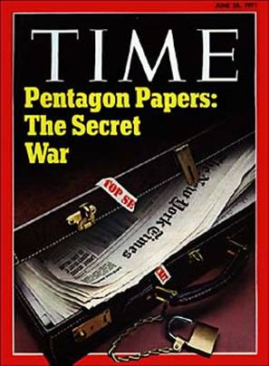
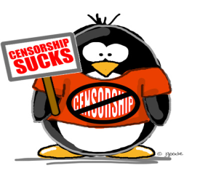
Prior Restraint
Prior Restraint is the attempt to limit freedom of the press by preventing material from being printed; thus, a form of censorship. Both of these cases tests the idea of prior restraint.
New York Times Co. v US (1971)
Court allowed printing of Pentagon Papers because they could not find any harm
Hazelwood v Kuhlmeier (1988)
School administrators can exercise censorship in school sponsor activities.

