Slide 1
Formal and Informal Change to the Constitution

Slide 2
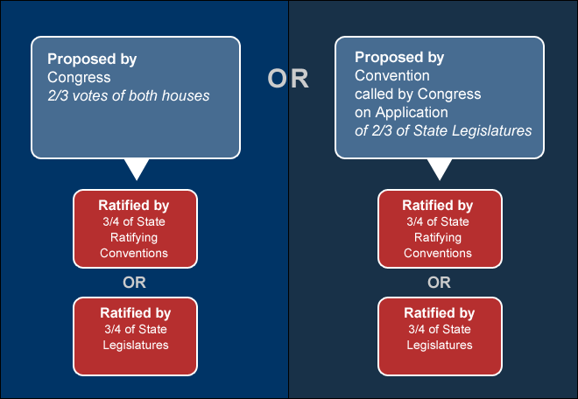
Formal Ways to Amend
2/3 Congress or State legislatures propose
3/4 of state conventions or legislature approves
Key Points
Passage requires a supermajority in both Congress and in the states
Illustrates federalism – nation and state

Slide 3
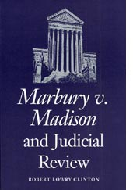
Informal Ways to Amend
Congressional Legislation
Laws clarify and expand the meaning of Constitution (Judiciary Act of 1789)
Executive Actions
Executive agreements
Judicial Decisions
Judicial review allows court to define or rule on constitutionality of laws or Presidential actions
Party Practices
Parties control Congressional committees and how they are led and organized
Unwritten traditions
Senatorial courtesy requires the President to seek Senator’s approval before nominating a judge to a seat in that Senator’s state.

Slide 4
Changing the Constitution - FRQ
Grading Scale
8 = A+ 7 = A-
6 = B+ 5 = B-
4 = C+ 3 = C-
2 = D 1 = F+
The United States Constitution has endured for more than two centuries as the framework of our government. However, the meaning of our Constitution has been changed by both formal and informal methods.
Identify 2 formal methods for adding amendments to the Constitution.
Describe 2 informal methods that have been used to change the Constitution. Provide one specific example for each informal method you describe.
Explain why informal methods are used more often than the formal amendment process.

Slide 5
Changing the Constitution - Answer
Grading Scale
8 = A+ 7 = A-
6 = B+ 5 = B-
4 = C+ 3 = C-
2 = D 1 = F+
2 points (1 point for each method identified)
Methods must include one method of proposal and one method of ratification
Methods of Proposal
2/3rds vote in both Houses
By national convention called by Congress at the request of 2/3rds of the states legislatures (never been used)
Methods of Ratification
By legislatures in 3/4^{ths} of the states
By conventions in 3/4^{ths} of the states
Students do not have to use exact fractions, but the do need to understand this is an extraordinary majority
Students do not have to use specific terms (supermajority, propose, ratify, federalism)

Slide 6
Changing the Constitution - Answer
Grading Scale
8 = A+ 7 = A-
6 = B+ 5 = B-
4 = C+ 3 = C-
2 = D 1 = F+
4 points
1 point for each description of informal methods; 1 point for each example
Acceptable informal methods
Courts (judicial review/interpretation/application)
Elastic clause (legislation by Congress)
Development of political customs
The example chosen must be linked to the method described
2 points
1 point for basic explanation; 1 point for elaboration (2 points total)
Basic explanation (“its harder to amend formally)
Second point requires further elaboration

