Slide 1
Federalism
Types of Federalism

Slide 2
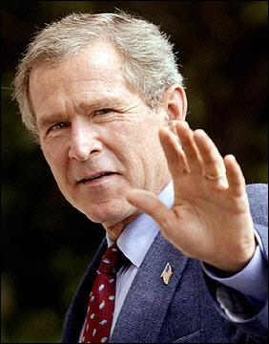
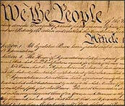
Elements of Government
Authority
Legitimacy
Power

Slide 3
Authority
The right to enforce people to comply with a decision that is made.

Slide 4
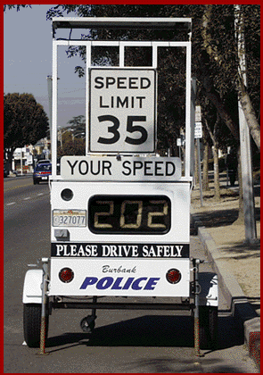
Legitimacy
Laws and authority must be appropriate and right.
If not, what will people do?
Is this law legitimate?

Slide 5
Power
The ability to enforce the law.
Power of coercion - force people to comply with laws. Totalitarian dictatorships.
POWER = THE ABILITY TO INFLUENCE

Slide 6
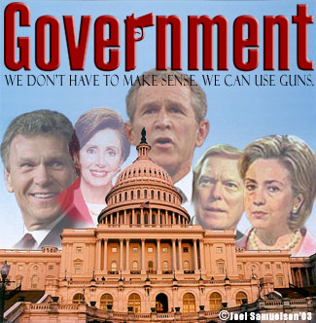
Three Systems of Government
Unitary - powers rest with central government; decisions at lower level cannot be overturned.
Dictator
Confederation - power comes from states; central power is limited.
Decentralized power.
AOC “weak” national Govn’t
Federal - Authority is shared among central and state government.
Constitution

Slide 7
How is the universe similar to federalism?
What does the sun represent? Large and small planets?
The genius of “Little Jimmy Madison”.

Slide 8
Federalism
The Founding Fathers chose federalism.
87, 453
Federal-Enumerated/Expressed
Delegated
State-10th ; Reserved
Local-10th Amend.
1
50

Slide 9
Benefits and Weaknesses to Federalism
Arguments against Federalism | Benefits of Federalism
Promotes inequality because states differ in resources they have to provide services Enables local interests to delay majority supported policies Creates confusion because the citizens to do not know each government’s responsibility | Promotes diverse policies encouraging creative ideas Provides multiple power center, thus making it difficult for one faction (interest group) to dominate Keeps the government close to the people by increasing opportunity to participate.

Slide 10
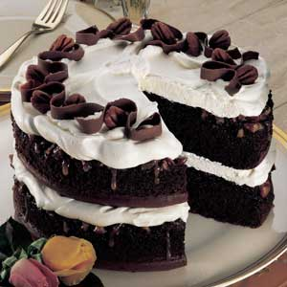
Two Types- Dual and Cooperative
Dual Federalism
State and federal government both remain supreme within their own spheres.
F- Military, Foreign Policy
S- Education, Transportation, Elections
“Layer Cake Federalism” - distinct layers of power.
This characterized America until Roosevelt’s New Deal of the 1930’s

Slide 11
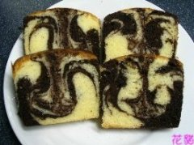
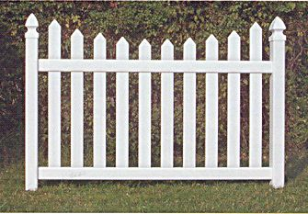
Two Types- Dual and Cooperative
Dual Federalism
Cooperative Federalism
State and federal should work together on policy and programs.
Aid to Families with Dependent Children
F- money
S- eligibility requirements
“Marble cake federalism” or “Picket-fence federalism”

Slide 12
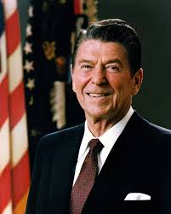
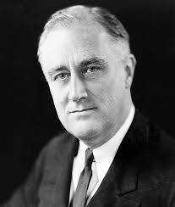
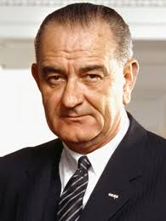
History of Federalism
New
Federalism
Dual Federalism
1789
1932
Cooperative
Federalism

