Slide 1
Federal Government Supremacy

Slide 2
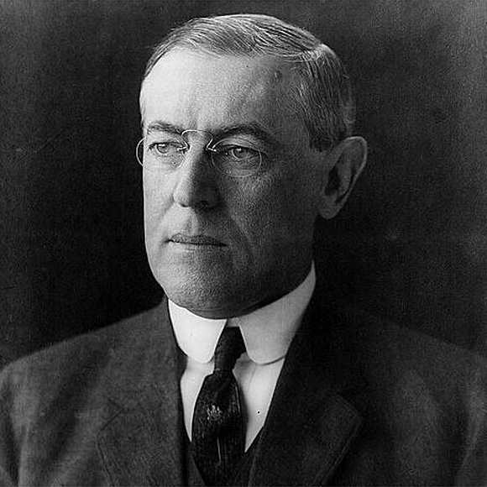
The Cardinal Question
When talking about the relationship between the national government and state governments Pres. Woodrow Wilson stated “it is the cardinal question of our constitutional system.”

Slide 3
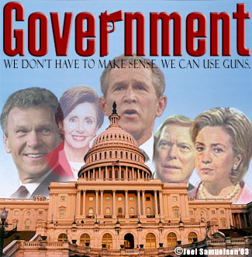
Three Systems of Government
Unitary - powers rest with central government; decisions at lower level cannot be overturned.
Dictator
Confederation - power comes from states; central power is limited.
Decentralized power.
AOC “weak” national Govn’t
Federal - Authority is shared among central and state government.
Constitution

Slide 4
The Constitutional Division of Powers
Expressed Powers
Implied Powers
Inherent Powers
Reserved Powers
Concurrent Powers
Prohibited Powers

Slide 5
The Constitutional Division of Powers
Expressed Powers
Specifically granted to the Federal Government
Implied Powers
Not stated in the Constitution, but derived from the “Necessary and Proper Clause”
Inherent Powers
Derived from the fact that the US is a sovereign nation
Reserved Powers
Concurrent Powers
Prohibited Powers
Held solely for the states
Exercised by both the nation and the state
Denied to nation, state, or both governments

Slide 6
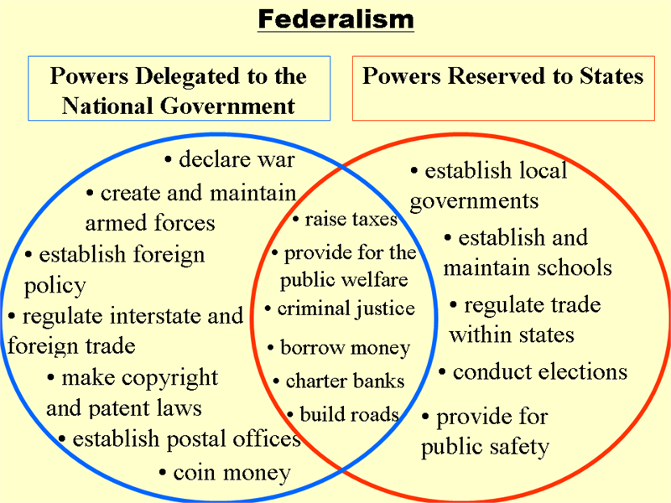
Vinn Diagram

Slide 7
McCulloch v Maryland
McCulloch v Maryland
Background
Constitutional Questions
Court Decision
Significance

Slide 8
McCulloch v Maryland
McCulloch v Maryland
Background | Congress had chartered a National Bank in 1816. Maryland tried to tax the NB branch in their state. The Maryland branch refused to pay the tax. Case went to the Supreme Court.
Constitutional Questions | Does the Constitution permit Congress to charter a bank? Does a state have a constitutional right to tax an agency of the US government?
Court Decision | Yes, Implied from Congress’ power to impose taxes, issue currency, and borrow money. No, it violates the Supremacy Clause
Significance | Confirmed the right of Congress to utilize Implied Powers. Validated the Supremacy of the National Government.

Slide 9
Gibbons v Ogden
Gibbons v Ogden
Background
Constitutional Questions
Court Decision
Significance

Slide 10
Gibbons v Ogden
Gibbons v Ogden
Background | The NY legislature granted Aaron Ogden an “exclusive license” to operate a ferry on the Hudson River between NY and NJ. Gibbons obtained the same license from the federal government.
Constitutional Questions | Did the NY law violate the Constitution by regulating interstate commerce? Does Congress have the exclusive right to regulate interstate commerce?
Court Decision | Chief Justice John Marshall defined commerce as “all business dealing…” including “…production, buying, selling, renting and transporting goods.” Gibbons right to compete was upheld.
Significance | Marshall’s broad definition allows Congress to promote economic growth in America.

Slide 11
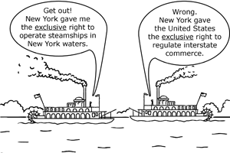
Federal Supremacy
McCulloch v. Maryland
“The power to tax is the power to destroy.”
Supremacy Clause used
Gibbons v. Ogden - federal government regulates interstate commerce NOT the states!
Commerce Clause used
Heart of Atlanta Motel v. US –segregation in public accommodations

Slide 12
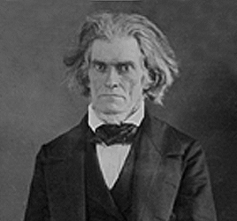
The Issue of Nullification
John C. Calhoun argued that a state can nullify or refuse to recognize an act of Congress.
The Civil War was not just a conflict over slavery, but a dispute between the Southern states and the national government.
Because the North wins the doctrine of Nullification is refuted and the national government is supreme.

Slide 13
Expanding the Commerce Clause
The commerce clause has played a key role in the expansion of federal power.
Example: the federal govn’t now regulates radio signals, telephone messages, financial transactions, etc.
The Supreme Court upheld the 1964 Civil Rights Act forbidding discrimination in the workplace on the basis of its power to regulate interstate commerce

Slide 14
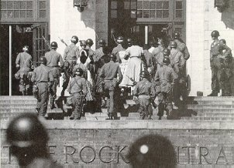
The Issue of School Desegregation
1954, Brown v Board upheld that school segregation was unconstitutional.
Pres. Eisenhower sent federal troops to Little Rock’s Central High School to enforce school desegregation.

Slide 15
States Interacting with Each Other

Slide 16
Article IV of the Constitution
Full Faith and Credit Clause—States are required to recognize the laws and legal documents of other states, such as birth certificates, marriage licenses, drivers' licenses, wills.
Privileges and Immunities Clause—States are prohibited from unreasonably discriminating against residents of other states. Nonresidents may travel through other states; buy, sell, and hold property; and enter into contracts (does not extend to political rights such as the right to vote or run for political office, or to the right to practice certain regulated professions such as teaching).
extradition—States may return fugitives to a state from which they have fled to avoid criminal prosecution at the request of the governor of the state.
interstate compacts—States may make agreements, sometimes requiring congressional approval, to work together to solve regional problems. Some examples are "hot-pursuit agreements," parole and probation agreements, the Port Authority of New York and New Jersey, and regulating the common use of shared natural resources.

