Slide 1
Executive Office of the President

Slide 2
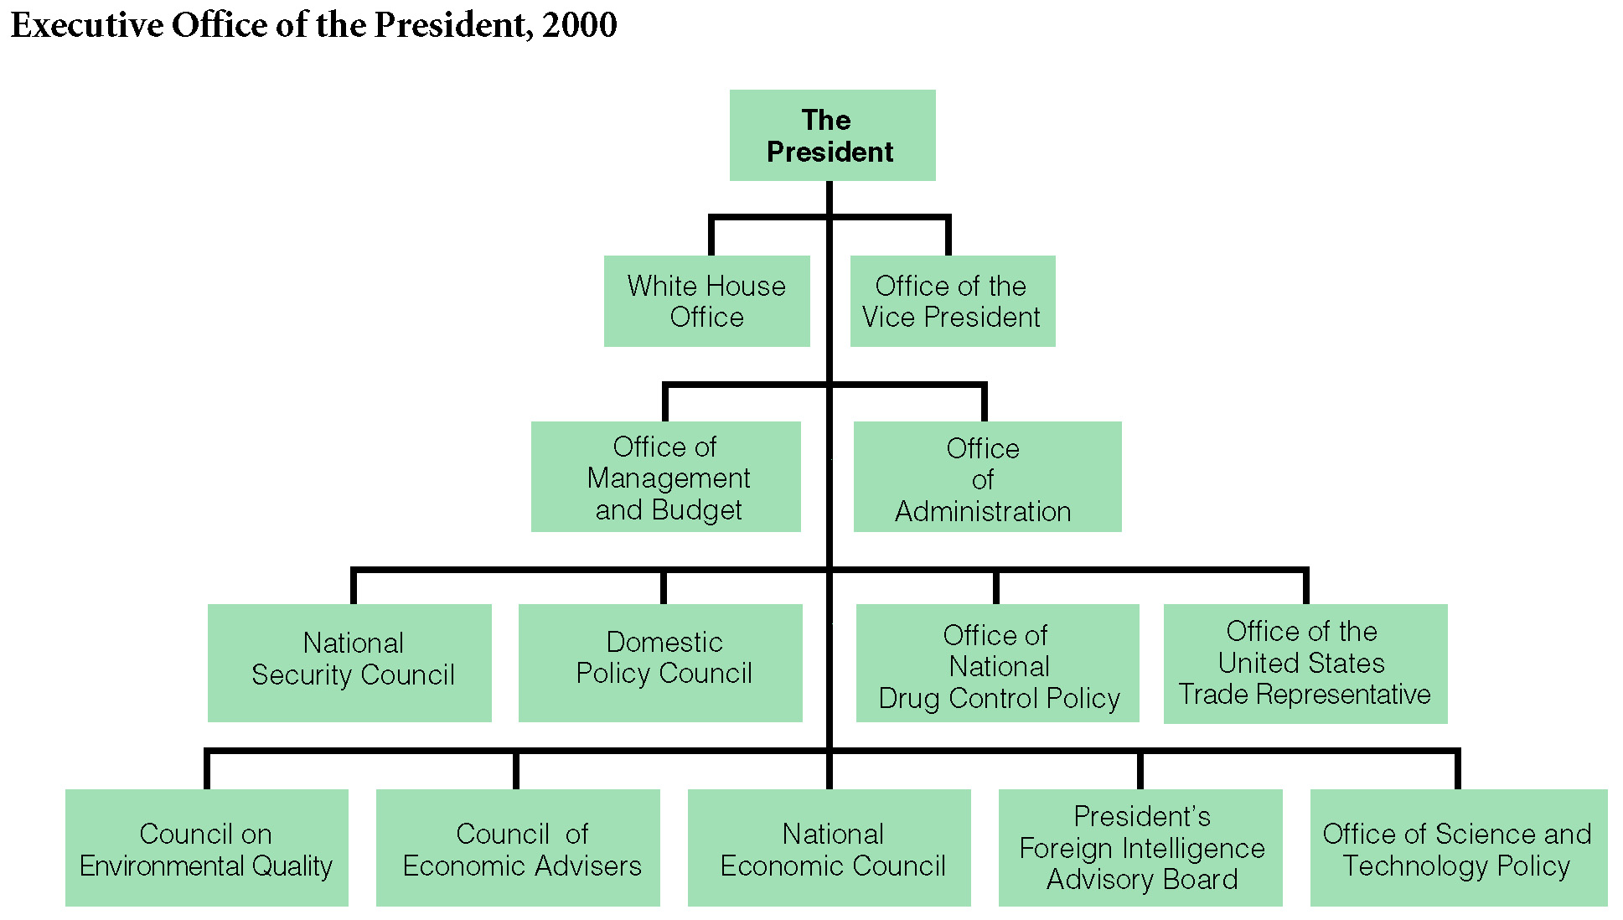
The Executive Office of the President
Office of Management and Budget (OMB)
Largest office, responsible for overseeing the preparation of the budget
National Security Council (NSC)
Foreign and military advisors who aid in foreign policy and national security
Council of Economic Advisors (CEA)
3 leading economist who assist with the economic policy.

Slide 3
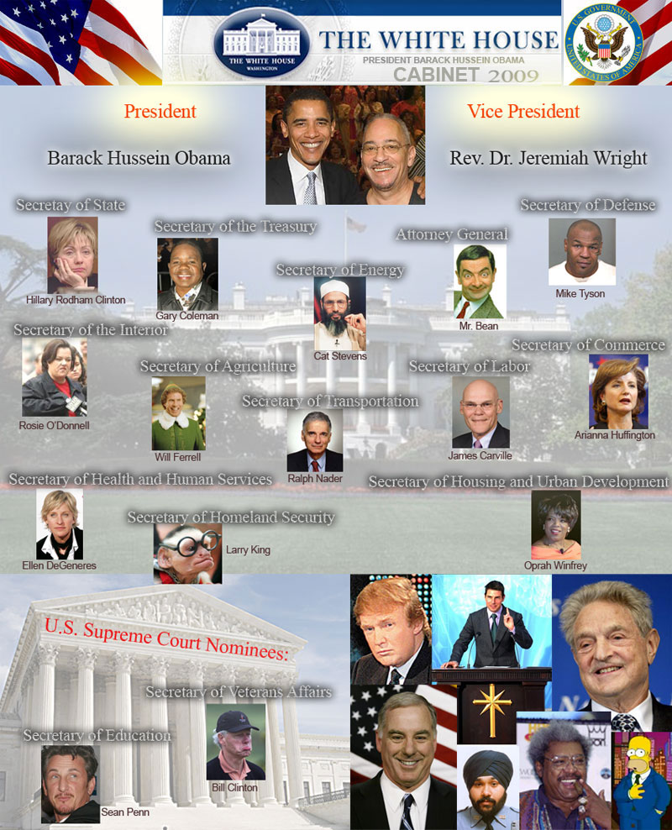
The Cabinet
Includes 14 department heads and the attorney general.
Have divided loyalties – partly to President and to their institutional goals of their own department.
Difficult to control because
Careers extend beyond 1 President
Interest Groups often form ties with Cabinet departments

Slide 4
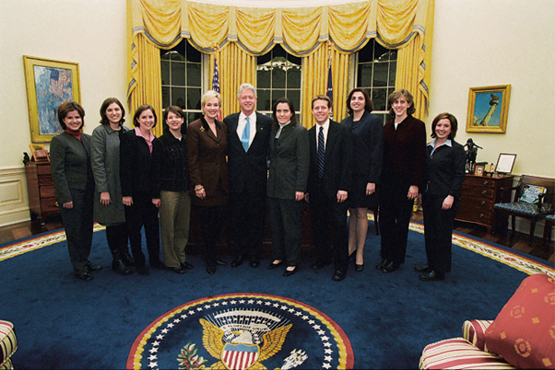
The White House Staff
Must be loyal to President
Appointed and dismissed by POTUS
Provide the President with policy options and analysis.
Chief of Staff
Highest ranking official who select’s key WH staff and managing flow of people and info into the Oval Office.
Press Secretary
Clinton’s White House Staff

Slide 5
Roles and Powers of the President

Slide 6
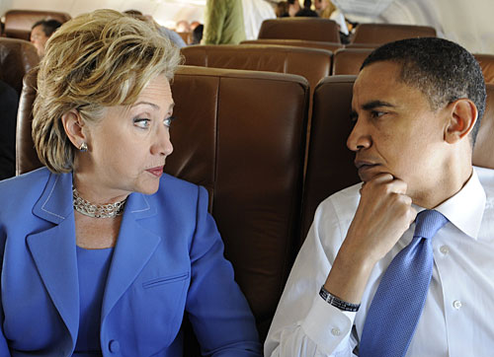
President as Chief Executive
The President enforces federal laws and administers a bureaucracy that includes 2.7 million civilian employees and spends more than $3 trillion a year
Appointment Power – The President has the power to appoint many top ranking officers of the federal government
Cabinet members and their top aides
Heads of independent agencies
Ambassadors and other diplomats
All federal judges, US Marshalls, attorneys
All are subject to confirmation by a majority of the Senate but may be removed by the President.
Limited by an unwritten rule known as senatorial courtesy – the Senate will not approve an appointment opposed by the majority party senator from the state where the appointee will serve.
President Obama and Sec. of State nominee Hilary Clinton

Slide 7
