Slide 1
Roles and Powers of the President

Slide 2
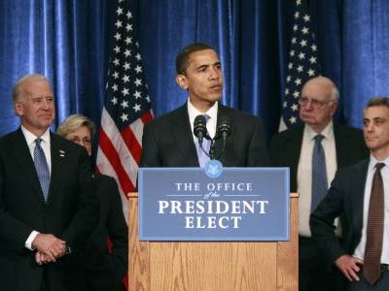
President as Chief Legislator
President is required to give State of Union Address to Congress
Can bring issue to Congress’ attention
Veto Legislation

Slide 3
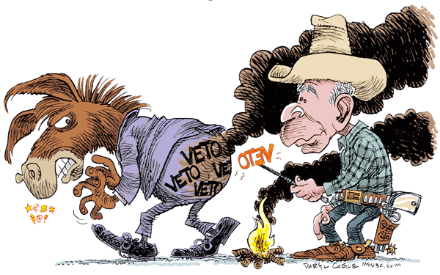
Veto Power
President’s options
Sign a bill into law
Wait 10 days = a law
Pocket veto – if Congress is expected to adjourn in less than 10 days
Veto (reject) but Congress may override that with 2/3rds vote in each chamber.
Less than 10% of vetoed bills are overridden (so a threat usually enough) and those that are will usually be revised and passed in another form.

Slide 4
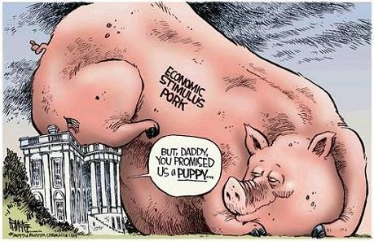
Line-Item Veto Power
President’s must accept or reject the entire bill, unlike many governors.
1996, Congress passed a Line-Item Veto Act giving POTUS the ability to strike down
individual items in major appropriations bills, hoping this would help reduce wasteful spending, pork, and earmarks.
Two years later the Supreme Court struck down the line-item veto as an unconstitutional expansion of the President’s power.

Slide 5
Working with Congress
President’s prefer a bipartisan relationship with Congress
Strategies used to influence Congress to pass legislation
Assigning legislative liaisons from the EOP to lobby legislators
Working with majority and minority leaders
Using the media
Using high Presidential approval ratings to persuade legislators to support programs
Bargaining and using “pork” that will benefit wavering Congressmen

Slide 6
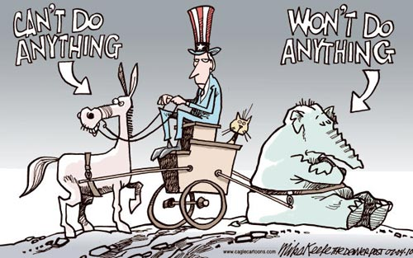
When Working with Congress – Don’t Work
Usually occurs when President and Congress, or the two chambers, are controlled by differing parties
Consequences of divided government…
Heightened partisanship and difficult to negotiate compromises
Creates gridlock
Created a decline in public trust in the go
Presidents overcome divided government…
Using media
Threatening use of veto
Make deals with key Congressional leaders
Building coalitions
Increase reliance on White House staff

