Slide 1
Roles and Powers of the President

Slide 2
President as Chief Diplomat
President can extend or cut relations with foreign countries.
Example: Carter recognized People’s Republic of China and severed relations with Iran.
Sole power to negotiate treaties
Examples: Carter – Panama Canal Treaty Wilson – Treaty of Versailles (ended WWI) Senate actually rejected this treaty
Presidents have began to rely on executive agreements because they do not need Congressional approval (therefore they are not part of American law)
Examples: Vietnam Peace Agreement SALT I (limiting offensive nuclear weapons)

Slide 3
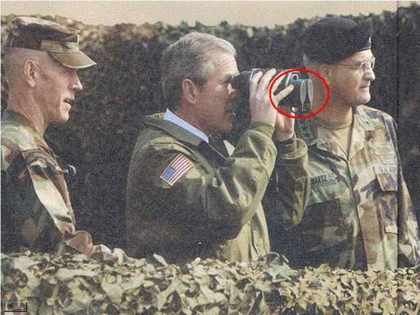
President as Commander-in-Chief
Since WWII modern Presidents have sent US forces into combat without formal declarations of war
Vietnam, Korea, Persian Gulf, and the Iraq War
1973 War Powers Resolution ensured Congressional involvement in military commitment.
President must notify Congress within 48 hours of deploying troops
President must bring troops home within 60 to 90 days unless Congress extends the time

Slide 4
National Security and Foreign Policy Powers
Formal Powers
Informal Powers
Deploy troops
Appoint ambassadors
Negotiate treaties
Recognize nations
Receive ambassadors from other public ministers
Negotiate executive agreements
Recognized global leader who meets with other leaders to build international coalitions
Manages international crisis
Access to information not available to Congress or the public

Slide 5
President vs Congress FR Q
Pass foreign policy laws
Regulate foreign commerce (including trade agreements)
Ratify Treaties
Executive agreements
Access to media/bully pulpit/morale building
Agenda setting
Meet with world leaders
Crisis manager
Negotiate/make Treaties
Recognition of nations
Receive ambassadors from other nations
Commander in chief – power to commit troops
Appointment of ambassadors
Confirm ambassadors
Power of the purse in military matters
Declare war
Crisis manager
International coalition building
Access to more information, expertise, and knowledge than Congress
Recognized as global leader

Slide 6
President vs Congress Foreign Policy FRQ
Presidents are generally thought to have an advantage over Congress in conducting foreign policy because of the formal and informal powers of the President.
Identify two formal powers of the President in making foreign policy.
Identify two formal powers of Congress in making foreign policy.
Identify two formal powers of the President that contribute that contribute to the Presidents advantage over Congress in conducting foreign policy.
Explain how each of the formal powers identified in (c) contributes to the Presidents advantage over Congress in conducting foreign policy.

